Slide 1
Introduction to CSS
Chapter 4

Slide 2
What Is CSS?
Cascading Style Sheets (CSS)
CSS is a W3C standard for describing the appearance of HTML elements
With CSS, we can assign font properties, colors, sizes, borders, background images, and even position elements on the page
CSS can be added directly to any HTML element (via the style attribute), within the <head> element, or, most commonly, in a separate text file that contains only CSS.

Slide 3
What Is CSS?
Benefits of CSS
Improved control over formatting.
Improved site maintainability.
Improved accessibility.
Improved page-download speed.
Improved output flexibility (responsive design)

Slide 4
What Is CSS?
CSS Versions
1996 the CSS Level 1 Recommendation was published
June 2011 - CSS2.1 becomes an official W3C Recommendation
a different group at the W3C was working on a CSS3 draft. So far the following CSS3 modules have made it to official W3C Recommendations:
CSS Selectors,
CSS Namespaces,
CSS Media Queries,
CSS Color, and
CSS Style Attributes

Slide 5
What Is CSS?
Browser Adoption
Historically implementation of CSS was not consistent across major browsers.
CSS has a reputation for being a somewhat frustrating language due to browser implementation differences
CSS was not really designed to be a layout language, so authors often find it tricky dealing with floating elements, relative positions, inconsistent height handling, overlapping margins, and non-intuitive naming

Slide 6
CSS Syntax
Overview
A CSS document consists of one or more style rules
A rule consists of a selector that identifies the HTML element or elements that will be affected, followed by a series of property:value pairs (each pair is also called a declaration)
The series of declarations is also called the declaration block .

Slide 7
Benefits of CSS
Why using CSS is a better way of describing presentation than HTML
The degree of formatting control in CSS is significantly better than that provided in HTML.
Web sites become significantly more maintainable because all formatting can be centralized into one, or a small handful, of CSS files.
CSS-driven sites are more accessible.
A site built using a centralized set of CSS files for all presentation will also be quicker to download because each individual HTML file will contain less markup.
CSS can be used to adopt a page for different output mediums.

Slide 8
CSS Syntax
Rules, properties, values, declarations
A CSS document consists of one or more style rules.
A rule consists of a selector that identifies the HTML element or elements that will be affected, followed by a series of property and value pairs (each pair is also called a declaration).

Slide 9
Declaration Blocks
The series of declarations is also called the declaration block.
A declaration block can be together on a single line, or spread across multiple lines.
The browser ignores white space
Each declaration is terminated with a semicolon.

Slide 10
Properties
Which style properties of the selected elements
Each individual CSS declaration must contain a property.
These property names are predefined by the CSS standard.
The CSS2.1 Recommendation defines over a hundred different property names.

Slide 11
Properties
Common CSS properties
Property Type | Property
Fonts | font font-family font-size font-style font-weight @font-face
Text | letter-spacing line-height text-align text-decoration text-indent
Color and background | background background-color background-image background-position background-repeat color
Borders | border border-color border-width border-style border-top border-top-color border-top-width etc

Slide 12
Properties
Common CSS properties continued.
Property Type | Property
Spacing | padding padding-bottom, padding-left, padding-right, padding-top margin margin-bottom, margin-left, margin-right, margin-top
Sizing | height max-height max-width min-height min-width width
Layout | bottom, left, right, top clear display float overflow position visibility z-index
Lists | list-style list-style-image list-style-type

Slide 13
Values
What style value for the properties
Each CSS declaration also contains a value for a property.
The unit of any given value is dependent upon the property.
Some property values are from a predefined list of keywords.
Others are values such as length measurements, percentages, numbers without units, color values, and URLs.

Slide 14
Color Values
CSS supports a variety of different ways of describing color
Method | Description | Example
Name | Use one of 17 standard color names. CSS3 has 140 standard names. | color: red; color: hotpink; /* CSS3 only */
RGB | Uses three different numbers between 0 and 255 to describe the Red, Green, and Blue values for the color. | color: rgb(255,0,0); color: rgb(255,105,180);
Hexadecimal | Uses a six-digit hexadecimal number to describe the red, green, and blue value of the color; each of the three RGB values is between 0 and FF (which is 255 in decimal). Notice that the hexadecimal number is preceded by a hash or pound symbol (#). | color: #FF0000; color: #FF69B4;
RGBa | Allows you to add an alpha, or transparency, value. This allows a background color or image to “show through” the color. Transparency is a value between 0.0 (fully transparent) and 1.0 (fully opaque). | color: rgb(255,0,0, 0.5);
HSL | Allows you to specify a color using Hue Saturation and Light values. This is available only in CSS3. HSLA is also available as well. | color: hsl(0,100%,100%); color: hsl(330,59%,100%);

Slide 15
Units of Measurement
There are multiple ways of specifying a unit of measurement in CSS
Some of these are relative units, in that they are based on the value of something else, such as the size of a parent element.
Others are absolute units, in that they have a real-world size.
Unless you are defining a style sheet for printing, it is recommended to avoid using absolute units.
Pixels are perhaps the one popular exception (though as we shall see later there are also good reasons for avoiding the pixel unit).

Slide 16
Relative Units
Unit | Description | Type
px | Pixel. In CSS2 this is a relative measure, while in CSS3 it is absolute (1/96 of an inch). | Relative (CSS2) Absolute (CSS3)
em | Equal to the computed value of the font-size property of the element on which it is used. When used for font sizes, the em unit is in relation to the font size of the parent. | Relative
% | A measure that is always relative to another value. The precise meaning of % varies depending upon which property it is being used. | Relative
ex | A rarely used relative measure that expresses size in relation to the x-height of an element’s font. | Relative
ch | Another rarely used relative measure; this one expresses size in relation to the width of the zero ("0") character of an element’s font. | Relative (CSS3 only)
rem | Stands for root em, which is the font size of the root element. Unlike em, which may be different for each element, the rem is constant throughout the document. | Relative (CSS3 only)
vw, vh | Stands for viewport width and viewport height. Both are percentage values (between 0 and 100) of the viewport (browser window). This allows an item to change size when the viewport is resized. | Relative (CSS3 only)

Slide 17
Absolute Units
Unit | Description | Type
in | Inches | Absolute
cm | Centimeters | Absolute
mm | Millimeters | Absolute
pt | Points (equal to 1/72 of an inch) | Absolute
pc | Pica (equal to 1/6 of an inch) | Absolute

Slide 18
Comments in CSS
It is often helpful to add comments to your style sheets. Comments take the form:
/* comment goes here */

Slide 19
Actually there are three …
Different types of style sheet
Author-created style sheets (what we are learning in this presentation).
User style sheets allow the individual user to tell the browser to display pages using that individual’s own custom style sheet. This option is available in a browser usually in its accessibility options area.
The browser style sheet defines the default styles the browser uses for each HTML element.

Slide 20
Style Locations
Author Created CSS style rules can be located in three different locations
CSS style rules can be located in three different locations.
Inline
Embedded
External
You can combine all 3!

Slide 21
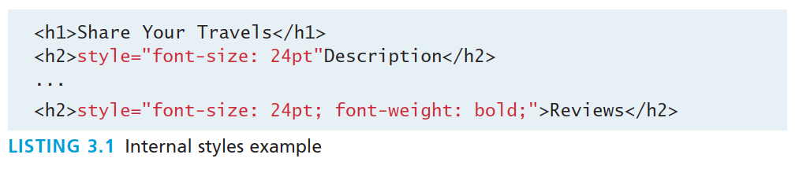
Inline Styles
Style rules placed within an HTML element via the style attribute
An inline style only affects the element it is defined within and will override any other style definitions for the properties used in the inline style.
Using inline styles is generally discouraged since they increase bandwidth and decrease maintainability.
Inline styles can however be handy for quickly testing out a style change.

Slide 22
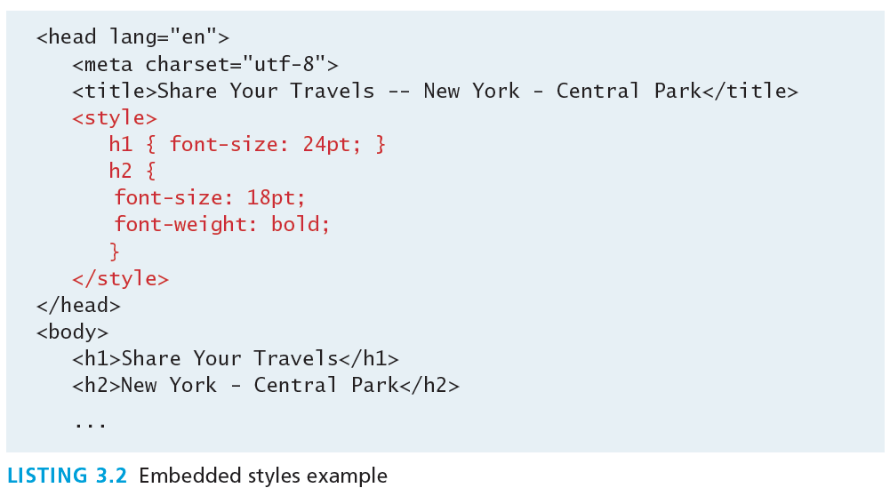
Embedded Style Sheet
Style rules placed within the <style> element inside the <head> element
While better than inline styles, using embedded styles is also by and large discouraged.
Since each HTML document has its own <style> element, it is more difficult to consistently style multiple documents when using embedded styles.

Slide 23
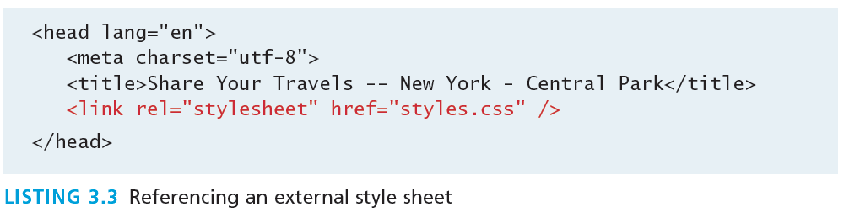
External Style Sheet
Style rules placed within a external text file with the .css extension
This is by far the most common place to locate style rules because it provides the best maintainability.
When you make a change to an external style sheet, all HTML documents that reference that style sheet will automatically use the updated version.
The browser is able to cache the external style sheet which can improve the performance of the site

Slide 24
Selectors
Things that make your life easier
When defining CSS rules, you will need to first need to use a selector to tell the browser which elements will be affected.
CSS selectors allow you to select
individual elements
multiple HTML elements,
elements that belong together in some way, or
elements that are positioned in specific ways in the document hierarchy.
There are a number of different selector types.

Slide 25
Element Selectors
Selects all instances of a given HTML element
Uses the HTML element name.
You can select all elements by using the universal element selector, which is the * (asterisk) character.

Slide 26
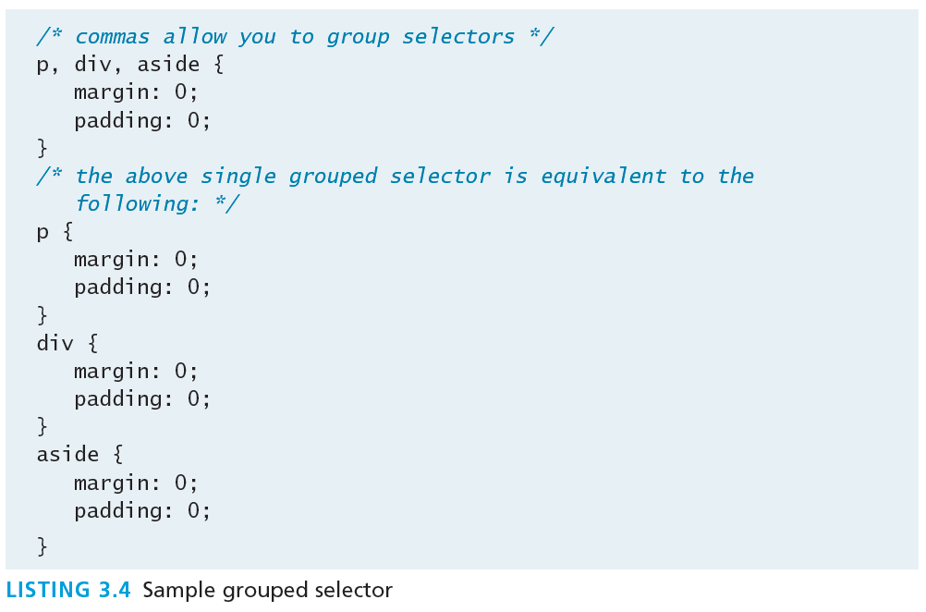
Grouped Selectors
Selecting multiple things
You can select a group of elements by separating the different element names with commas.
This is a sensible way to reduce the size and complexity of your CSS files, by combining multiple identical rules into a single rule.

Slide 27
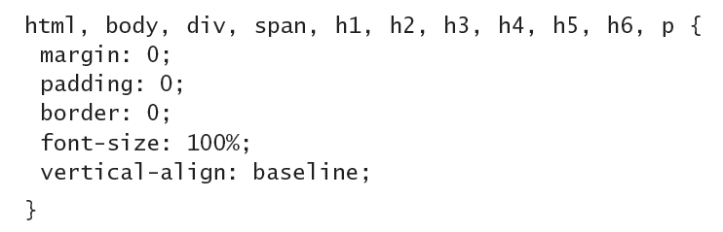
Reset
Grouped selectors are often used as a way to quickly reset or remove browser defaults.
The goal of doing so is to reduce browser inconsistencies with things such as margins, line heights, and font sizes.
These reset styles can be placed in their own css file (perhaps called reset.css) and linked to the page before any other external styles sheets.

Slide 28
Class Selectors
Simultaneously target different HTML elements
A class selector allows you to simultaneously target different HTML elements regardless of their position in the document tree.
If a series of HTML element have been labeled with the same class attribute value, then you can target them for styling by using a class selector, which takes the form: period (.) followed by the class name.

Slide 29
Class Selectors
<head>
<title>Share Your Travels </title>
<style>
.first {
font-style: italic;
color: brown;
}
</style>
</head>
<body>
<h1 class="first">Reviews</h1>
<div>
<p class="first">By Ricardo on <time>September 15, 2012</time></p>
<p>Easy on the HDR buddy.</p>
</div>
<hr/>
<div>
<p class="first">By Susan on <time>October 1, 2012</time></p>
<p>I love Central Park.</p>
</div>
<hr/>
</body>

Slide 30
Id Selectors
Target a specific element by its id attribute
An id selector allows you to target a specific element by its id attribute regardless of its type or position.
If an HTML element has been labeled with an id attribute, then you can target it for styling by using an id selector, which takes the form: pound/hash (#) followed by the id name.
Note: You should only be using an id once per page

Slide 31
Id Selectors
<head lang="en">
<meta charset="utf-8">
<title>Share Your Travels -- New York - Central Park</title>
<style>
#latestComment {
font-style: italic;
color: brown;
}
</style>
</head>
<body>
<h1>Reviews</h1>
<div id="latestComment">
<p>By Ricardo on <time>September 15, 2012</time></p>
<p>Easy on the HDR buddy.</p>
</div>
<hr/>
<div>
<p>By Susan on <time>October 1, 2012</time></p>
<p>I love Central Park.</p>
</div>
<hr/>
</body>

Slide 32
Id versus Class Selectors
How to decide
Id selectors should only be used when referencing a single HTML element since an id attribute can only be assigned to a single HTML element.
Class selectors should be used when (potentially) referencing several related elements.

Slide 33
Attribute Selectors
Selecting via presence of element attribute or by the value of an attribute
An attribute selector provides a way to select HTML elements by either the presence of an element attribute or by the value of an attribute.
This can be a very powerful technique, but because of uneven support by some of the browsers, not all web authors have used them.
Attribute selectors can be a very helpful technique in the styling of hyperlinks and images.

Slide 34
Attribute Selectors
<head lang="en">
<meta charset="utf-8">
<title>Share Your Travels</title>
<style>
[title] {
cursor: help;
padding-bottom: 3px;
border-bottom: 2px dotted blue;
text-decoration: none;
}
</style>
</head>
<body>
<div>
<img src="images/flags/CA.png" title="Canada Flag" />
<h2><a href="countries.php?id=CA" title="see posts from Canada">
Canada</a>
</h2>
<p>Canada is a North American country consisting of … </p>
<div>
<img src="images/square/6114907897.jpg" title="At top of Sulpher Mountain">
<img src="images/square/6592317633.jpg" title="Grace Presbyterian Church">
<img src="images/square/6592914823.jpg" title="Calgary Downtown">
</div>
</div>
</body>

Slide 35
Pseudo Selectors
Select something that does not exist explicitly as an element
A pseudo-element selector is a way to select something that does not exist explicitly as an element in the HTML document tree but which is still a recognizable selectable object.
A pseudo-class selector does apply to an HTML element, but targets either a particular state or, in CSS3, a variety of family relationships.
The most common use of this type of selectors is for targeting link states.

Slide 36
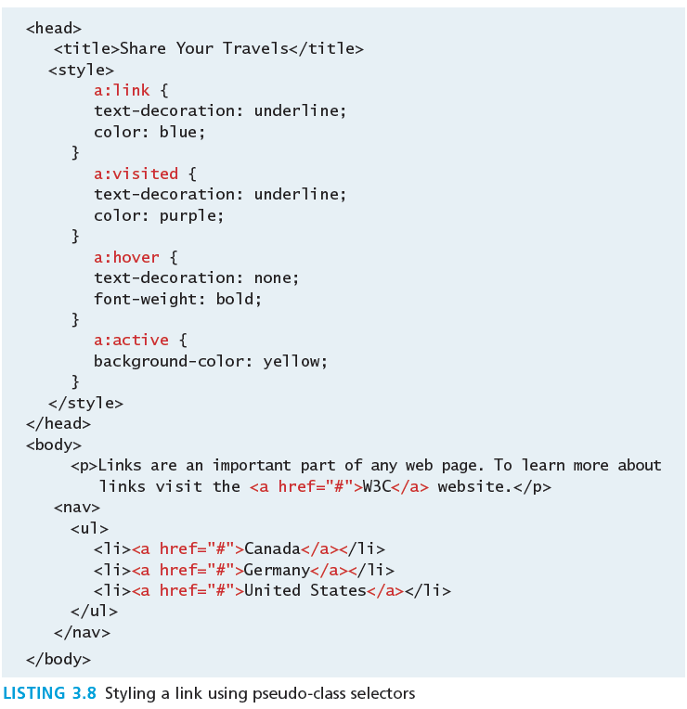
Pseudo Selectors

Slide 37
Contextual Selectors
Select elements based on their ancestors, descendants, or siblings
A contextual selector (in CSS3 also called combinators) allows you to select elements based on their ancestors, descendants, or siblings.
That is, it selects elements based on their context or their relation to other elements in the document tree.

Slide 38
Contextual Selectors
Selector | Matches | Example
Descendant | A specified element that is contained somewhere within another specified element | div p Selects a <p> element that is contained somewhere within a <div> element. That is, the <p> can be any descendant, not just a child.
Child | A specified element that is a direct child of the specified element | div>h2 Selects an <h2> element that is a child of a <div> element.
Adjacent Sibling | A specified element that is the next sibling (i.e., comes directly after) of the specified element. | h3+p Selects the first <p> after any <h3>.
General Sibling | A specified element that shares the same parent as the specified element. | h3~p Selects all the <p> elements that share the same parent as the <h3>.

Slide 39
Descendant Selector
Selects all elements that are contained within another element
While some of these contextual selectors are used relatively infrequently, almost all web authors find themselves using descendant selectors.
A descendant selector matches all elements that are contained within another element. The character used to indicate descendant selection is the space character.

Slide 40
Contextual Selectors in Action

Slide 41
Why Conflict Happens
In CSS that is
Because
there are three different types of style sheets (author-created, user-defined, and the default browser style sheet),
author-created stylesheets can define multiple rules for the same HTML element,
CSS has a system to help the browser determine how to display elements when different style rules conflict.

Slide 42
Cascade
How conflicting rules are handled in CSS
The “Cascade” in CSS refers to how conflicting rules are handled.
The visual metaphor behind the term cascade is that of a mountain stream progressing downstream over rocks.
The downward movement of water down a cascade is meant to be analogous to how a given style rule will continue to take precedence with child elements.

Slide 43
Cascade Principles
CSS uses the following cascade principles to help it deal with conflicts:
inheritance,
specificity,
location

Slide 44
Inheritance
Cascade Principle #1
Many (but not all) CSS properties affect not only themselves but their descendants as well.
Font, color, list, and text properties are inheritable.
Layout, sizing, border, background and spacing properties are not.

Slide 45
Inheritance

Slide 46
Inheritance
How to force inheritance
It is possible to tell elements to inherit properties that are normally not inheritable.

Slide 47
Inheritance

Slide 48
Specificity
Cascade Principle #2
Specificity is how the browser determines which style rule takes precedence when more than one style rule could be applied to the same element.
The more specific the selector, the more it takes precedence (i.e., overrides the previous definition).

Slide 49
Specificity
How it works
The way that specificity works in the browser is that the browser assigns a weight to each style rule.
When several rules apply, the one with the greatest weight takes precedence.

Slide 50
Specificity
These color and font-weight properties are inheritable and thus potentially applicable to all the child elements contained within the body.
However, because the <div> and <p> elements also have the same properties set, they override the value defined for the <body> element because their selectors (div and p) are more specific.
Class selectors are more specific than element selectors, and thus take precedence and override element selectors.
Id selectors are more specific than class selectors, and thus take precedence and override class selectors.

Slide 51
Specificity Algorithm
The algorithm that is used to determine specificity is :
First count 1 if the declaration is from a 'style' attribute in the HTML, 0 otherwise (let that value = a).
Count the number of ID attributes in the selector (let that value = b).
Count the number of other attributes and pseudo-classes in the selector (let that value = c).
Count the number of element names and pseudo-elements in the selector (let that value = d).
Finally, concatenate the four numbers a+b+c+d together to calculate the selector’s specificity.

Slide 52
Specificity Algorithm

Slide 53
Location
Cascade Principle #3
When inheritance and specificity cannot determine style precedence, the principle of location will be used.
The principle of location is that when rules have the same specificity, then the latest are given more weight.

Slide 54
Location
Can you guess what will be the color of the sample text ?

Slide 55
Location
What color would the sample text be if there wasn’t an inline style definition?

Slide 56
Location
There’s always an exception
There is one exception to the principle of location.
If a property is marked with !important in an author-created style rule, then it will override any other author-created style regardless of its location.
The only exception is a style marked with !important in an user style sheet; such a rule will override all others.

Slide 57
The BOX MODEL
Section 6 of 7

Slide 58
The Box Model
Time to think inside the box
In CSS, all HTML elements exist within an element box.
It is absolutely essential that you familiarize yourself with the terminology and relationship of the CSS properties within the element box.

Slide 59
The Box Model

Slide 60
Background
Box Model Property #1
The background color or image of an element fills an element out to its border (if it has one that is).
In contemporary web design, it has become extremely common too use CSS to display purely presentational images (such as background gradients and patterns, decorative images, etc) rather than using the <img> element.

Slide 61
Background Properties
Property | Description
background | A combined short-hand property that allows you to set the background values in one property. While you can omit properties with the short-hand, do remember that any omitted properties will be set to their default value.
background-attachment | Specifies whether the background image scrolls with the document (default) or remains fixed. Possible values are: fixed, scroll.
background-color | Sets the background color of the element.
background-image | Specifies the background image (which is generally a jpeg, gif, or png file) for the element. Note that the URL is relative to the CSS file and not the HTML. CSS3 introduced the ability to specify multiple background images.
background-position | Specifies where on the element the background image will be placed. Some possible values include: bottom, center, left, and right. You can also supply a pixel or percentage numeric position value as well. When supplying a numeric value, you must supply a horizontal/vertical pair; this value indicates its distance from the top left corner of the element.
background-repeat | Determines whether the background image will be repeated. This is a common technique for creating a tiled background (it is in fact the default behavior). Possible values are: repeat, repeat-x, repeat-y, and no-repeat.
background-size | New to CSS3, this property lets you modify the size of the background image.

Slide 62
Background Repeat

Slide 63
Background Position

Slide 64
Borders
Box Model Property #2
Borders provide a way to visually separate elements.
You can put borders around all four sides of an element, or just one, two, or three of the sides.

Slide 65
Borders
Property | Description
border | A combined short-hand property that allows you to set the style, width, and color of a border in one property. The order is important and must be: border-style border-width border-color
border-style | Specifies the line type of the border. Possible values are: solid, dotted, dashed, double, groove, ridge, inset, and outset.
border-width | The width of the border in a unit (but not percents). A variety of keywords (thin, medium, etc) are also supported.
border-color | The color of the border in a color unit.
border-radius | The radius of a rounded corner.
border-image | The URL of an image to use as a border.

Slide 66
Shortcut notation
TRBL
With border, margin, and padding properties, there are long-form and shortcut methods to set the 4 sides
border-top-color: red; /* sets just the top side */
border-right-color: green; /* sets just the right side */
border-bottom-color: yellow; /* sets just the bottom side */
border-left-color: blue; /* sets just the left side */
border-color: red; /* sets all four sides to red */
border-color: red green orange blue; /* sets all four sides differently */
When using this multiple values shortcut, they are applied in clockwise order starting at the top.
Thus the order is: top right bottom left.

Slide 67
Margins and Padding
Box Model Properties #3 and #4

Slide 68
Margins
Why they will cause you trouble.
Did you notice that the space between paragraphs one and two and between two and three is the same as the space before paragraph one and after paragraph three?
This is due to the fact that adjoining vertical margins collapse.

Slide 69



Collapsing Margins
If overlapping margins did not collapse, then margin space for would be 180p (90pixels for the bottom margin of the first <div> + 90 pixels for the top margin of the second <div>), while the margins and for would be 100px.
However, as you can see this is not the case.

Slide 70
Collapsing Margins
How it works
When the vertical margins of two elements touch,
the largest margin value of the elements will be displayed
the smaller margin value will be collapsed to zero.
Horizontal margins, on the other hand, never collapse.
To complicate matters even further, there are a large number of special cases in which adjoining vertical margins do not collapse.

Slide 71
Width and Height
Box Model Properties #5 and #6
The width and height properties specify the size of the element’s content area.
Perhaps the only rival for collapsing margins in troubling our students, box dimensions have a number of potential issues.

Slide 72
Width and Height
Potential Problem #1
Only block-level elements and non-text inline elements such as images have a width and height that you can specify.
By default the width of and height of elements is the actual size of the content.
For text,
this is determined by the font size and font face;
For images,
the width and height of the actual image in pixels determines the element box’s dimensions.

Slide 73
Width and Height
Potential Problem #2
Since the width and the height refer to the size of the content area, by default, the total size of an element is equal to not only its content area, but also to the sum of its padding, borders, and margins.

Slide 74
Default

Slide 75
Width and Height

Slide 76
Overflow Property

Slide 77
Sizing Elements
Time to embrace ems and percentages
While the previous examples used pixels for its measurement, many contemporary designers prefer to use percentages or em units for widths and heights.
When you use percentages, the size is relative to the size of the parent element.
When you use ems, the size of the box is relative to the size of the text within it.
The rationale behind using these relative measures is to make one’s design scalable to the size of the browser or device that is viewing it.

Slide 79
Developer Tools
Help is on the way
Developer tools in current browsers make it significantly easier to examine and troubleshot CSS than was the case a decade ago.
You can use the various browsers’ CSS inspection tools to examine, for instance, the box values for a selected element.

Slide 80
Developer Tools

Slide 81
TEXT STYLING
Section 7 of 7

Slide 82
Text Properties
Two basic types
CSS provides two types of properties that affect text.
font properties that affect the font and its appearance.
paragraph properties that affect the text in a similar way no matter which font is being used.

Slide 83
Font-Family
A few issues here
A word processor on a desktop machine can make use of any font that is installed on the computer; browsers are no different.
However, just because a given font is available on the web developer’s computer, it does not mean that that same font will be available for all users who view the site.
For this reason, it is conventional to supply a so-called web font stack, that is, a series of alternate fonts to use in case the original font choice in not on the user’s computer.

Slide 84
Specifying the Font-Family

Slide 85
Generic Font-Family
The font-family property supports five different generic families.
The browser supports a typeface from each family.

Slide 86
@font-face
The future is now
Over the past few years, the most recent browser versions have begun to support the @font-face selector in CSS.
This selector allows you to use a font on your site even if it is not installed on the end user’s computer.
Due to the on-going popularity of open source font sites such as Google Web Fonts (http://www.google.com/webfonts) and Font Squirrel (http://www.fontsquirrel.com/), @font-face seems to have gained a critical mass of widespread usage.

Slide 87
Font Sizes
Mo control, mo problems
The issue of font sizes is unfortunately somewhat tricky.
In a print-based program such as a word processor, specifying a font size in points is unproblematic.
However, absolute units such as points and inches do not translate very well to pixel-based devices.
Somewhat surprisingly, pixels are also a problematic unit.
Newer mobile devices in recent years have been increasing pixel densities so that a given CSS pixel does not correlate to a single device pixel.

Slide 88
Font Sizes
Welcome ems and percents again
If we wish to create web layouts that work well on different devices, we should learn to use relative units such as em units or percentages for our font sizes (and indeed for other sizes in CSS as well).
One of the principles of the web is that the user should be able to change the size of the text if he or she so wishes to do so.
Using percentages or em units ensures that this user action will work.

Slide 89
How to use ems and percents
When used to specify a font size, both em units and percentages are relative to the parent’s font size.

Slide 90
How to use ems and percents

Slide 91
How to use ems and percents
It might seem easy … but it’s not …
While this looks pretty easy to master, things unfortunately can quickly become quite complicated.
Remember that percents and em units are relative to their parents, so if the parent font size changes, this affects all of its contents.

Slide 92
ems and percents

Slide 93
The rem unit
Solution to font sizing hassles?
CSS3 now supports a new relative measure, the rem (for root em unit).
This unit is always relative to the size of the root element (i.e., the <html> element).
However, since Internet Explorer prior to version 9 do not support the rem units, you need to provide some type of fallback for those browsers.

Slide 94
The rem unit

